Slide 1
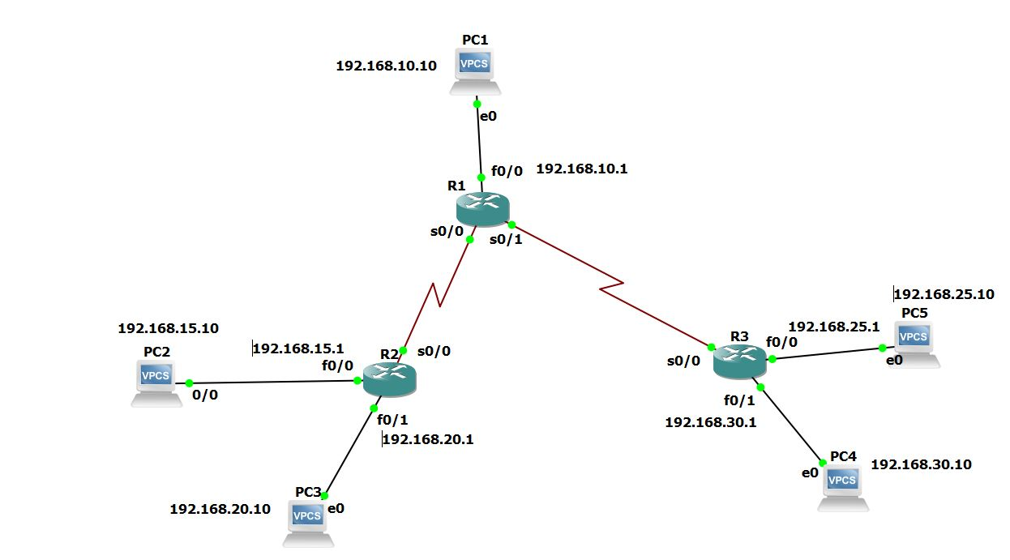
Routing estático - GNS3
192.168.10.0
10.0.2.0
192.168.25.0
10.0.1.0
192.168.15.0
192.168.20.0
192.168.30.0

Slide 2
Configurações R1 e R2
R1#config t
R1(config)#int fas0/0
R1(config-if)#ip add 192.168.10.1 255.255.255.0
R1(config-if)#no shutdown
R1(config-if)#
R1(config-if)#end
R1#copy running-config startup-config
R1#config t
R1(config)#int serial 0/0
R1(config-if)#ip add 10.0.1.2 255.255.255.0
R1(config-if)#no shutdown
R1(config-if)#end
R1#copy running-config startup-config
R1#config t
R1(config)#int serial 0/1
R1(config-if)#ip add 10.0.2.1 255.255.255.0
R1(config-if)#no shutdown
R1(config-if)#end
R1#copy running-config startup-config
R1#config t
R1(config)#ip route 192.168.15.0 255.255.255.0 10.0.1.1
R1(config)#ip route 192.168.20.0 255.255.255.0 10.0.1.1
R1(config)#ip route 192.168.25.0 255.255.255.0 10.0.2.2
R1(config)#ip route 192.168.30.0 255.255.255.0 10.0.2.2
R1(config)#end
R1#copy running-config startup-config
R2#config t
R2(config)#int fast0/0
R2(config-if)#ip add 192.168.15.1 255.255.255.0
R2(config-if)#no shutdown
R2(config-if)#end
R2#copy running-config startup-config
R2#config t
R2(config)#int fast0/1
R2(config-if)#ip add 192.168.20.1 255.255.255.0
R2(config-if)#no shutdown
R2(config-if)#end
R2#copy running-config startup-config
R2#config t
R2(config)#int serial 0/0
R2(config-if)#ip add 10.0.1.1 255.255.255.0
R2(config-if)#no shutdown
R2(config-if)#end
R2#copy running-config startup-config
R2#config t
R2(config)#ip route 192.168.10.0 255.255.255.0 10.0.1.2
R2(config)#ip route 192.168.25.0 255.255.255.0 10.0.1.2
R2(config)#ip route 192.168.30.0 255.255.255.0 10.0.1.2
R2(config)#end
R2#copy running-config startup-config

Slide 3
Configurações R3
R3#config t
R3(config)#int fast0/0
R3(config-if)#ip add 192.168.25.1 255.255.255.0
R3(config-if)#no shutdown
R3(config-if)#end
R3#copy running-config startup-config
R3#config t
R3(config)#int fast0/1
R3(config-if)#ip add 192.168.30.1 255.255.255.0
R3(config-if)#no shutdown
R3(config-if)#end
R3#copy running-config startup-config
R3#config t
R3(config)#int serial 0/0
R3(config-if)#ip add 10.0.2.2 255.255.255.0
R3(config-if)#no shutdown
R3(config-if)#end
R3#copy running-config startup-config
R3#config t
R3(config)#ip route 192.168.10.0 255.255.255.0 10.0.2.1
R3(config)#ip route 192.168.15.0 255.255.255.0 10.0.2.1
R3(config)#ip route 192.168.20.0 255.255.255.0 10.0.2.1
R3(config)#end
R3#copy running-config startup-config

Slide 4
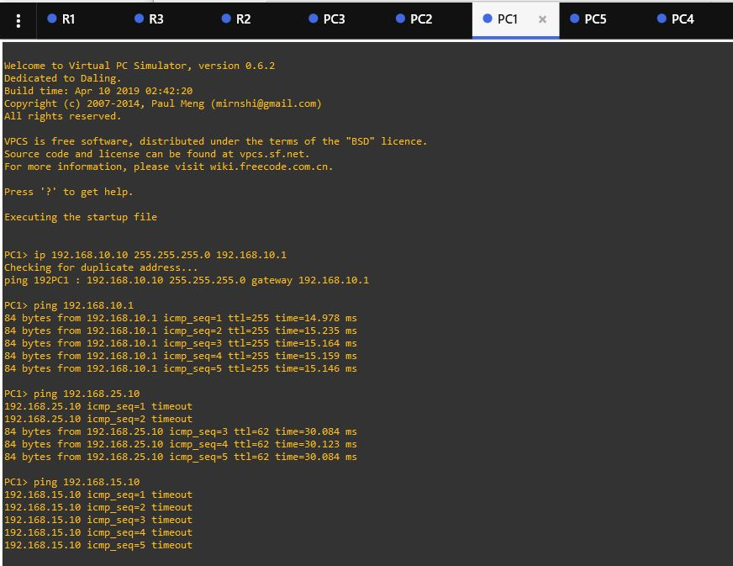
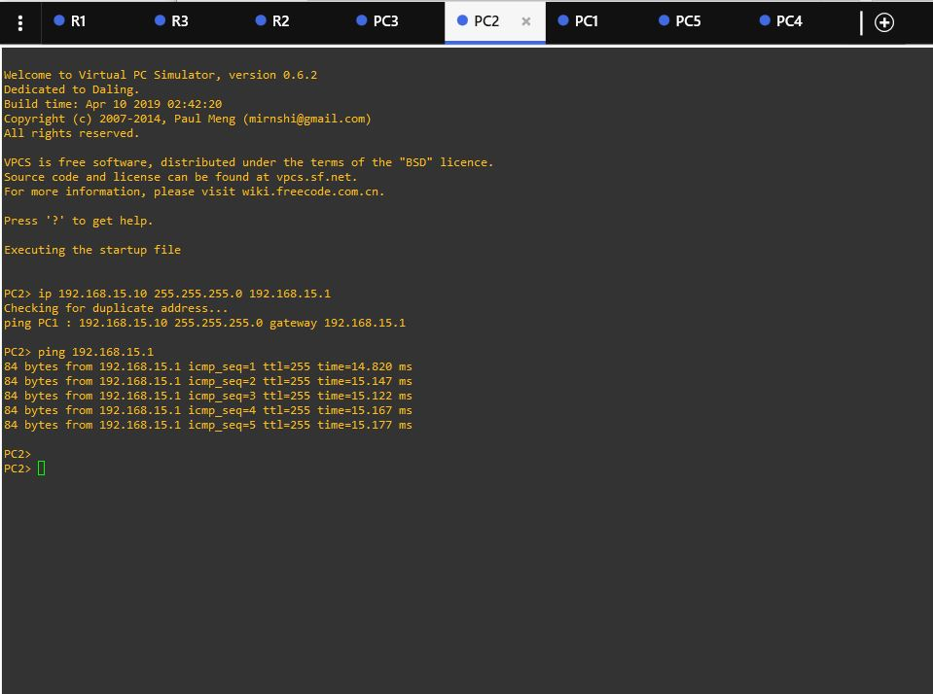
Configurações PCs e Testes

Slide 5
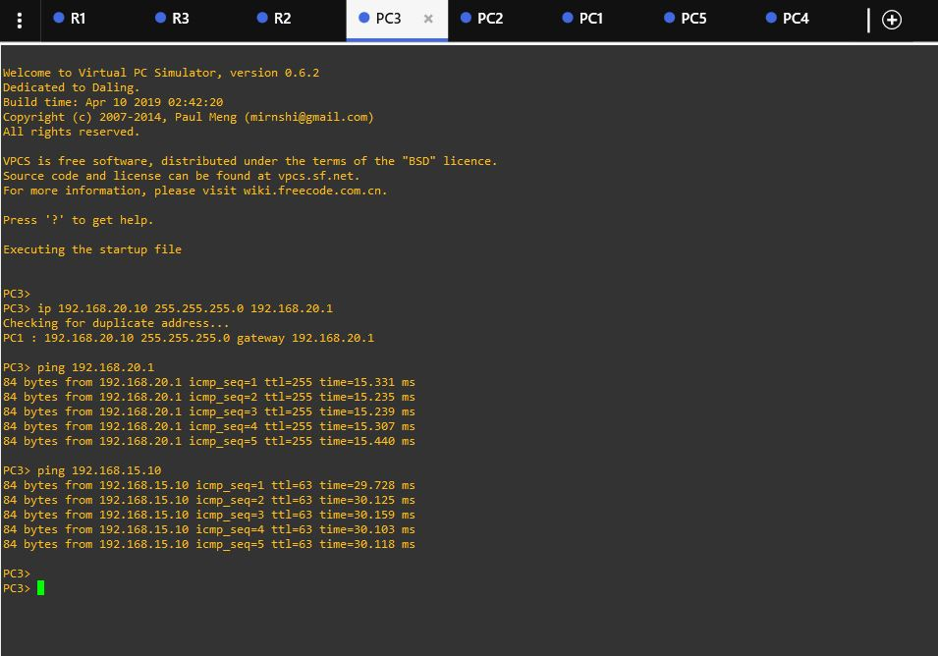
Configurações PCs e Testes

Slide 6
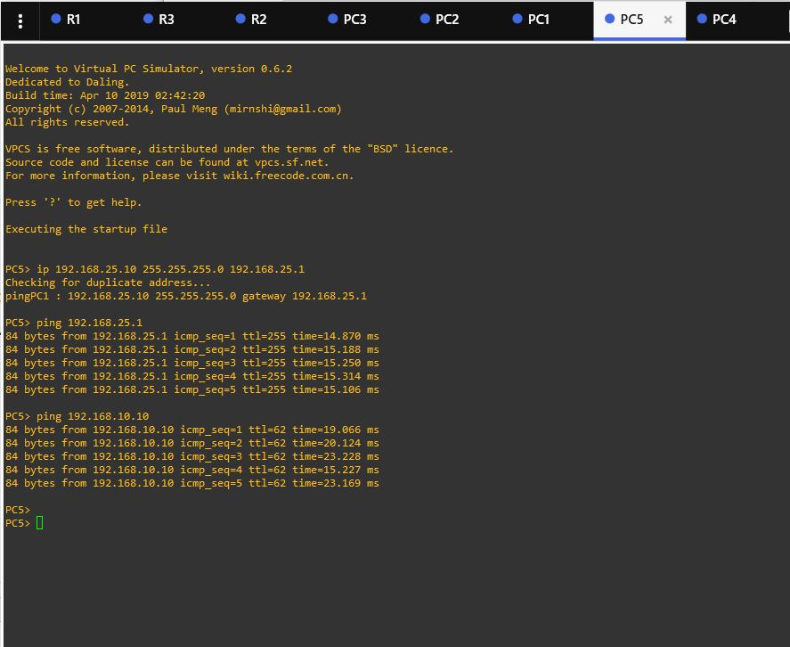
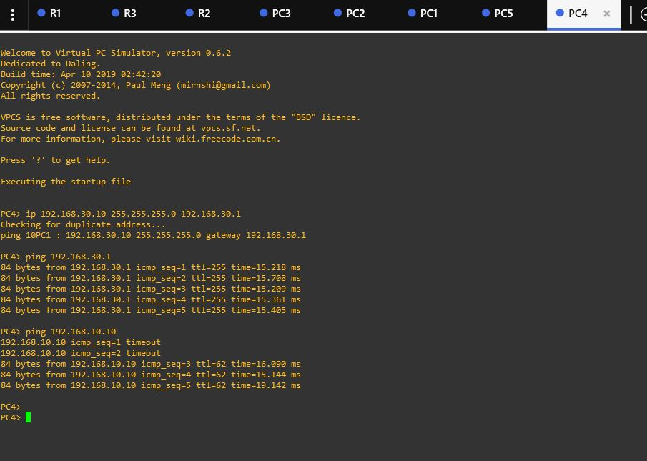
Configurações PCs e Testes

